Slide 1

Network Security
CS-411
Lecture # 03 - Cryptography

Slide 2
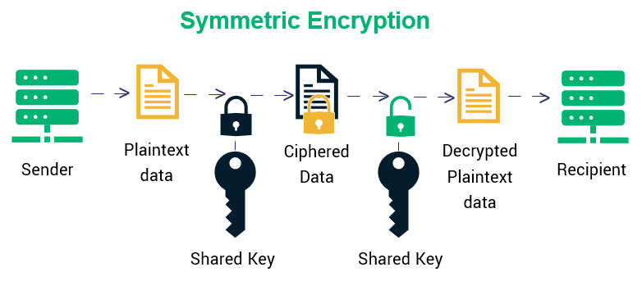
Symmetric Key Cryptography DES and IDEA

Slide 3
Data Encryption Standard - DES
It was designed by IBM in 1976 for the National Bureau of Standards (NBS), with approval from the National Security Agency (NSA).
It had been used as a standard for encryption until 2000.
From 2001 the AES has replaced DES.
After 25 years of analysis, the only security problem with DES found is that its key length is too short.
Although its wide spread use came to an end, its design idea is still used in most block ciphers
DES is a block cipher that takes a plaintext string as input and creates a ciphertext string of the same length.
It uses a symmetric key, which means that the same key is used to convert ciphertext back into plaintext.

Slide 4
DES
The DES block size is 64 bits. The key size is also 64 bits, although 8 bits of the key are used for parity (error detection), which makes the effective DES key size 56 bits.
DES uses the two basic techniques of cryptography - confusion and diffusion.
At the simplest level, diffusion is achieved through numerous permutations and confusions is achieved through the XOR operation.
A block to be enciphered is subjected to an initial permutation IP and then to a complex key-dependent computation and finally to a permutation which is the inverse of the initial permutation IP⁻¹

Slide 5
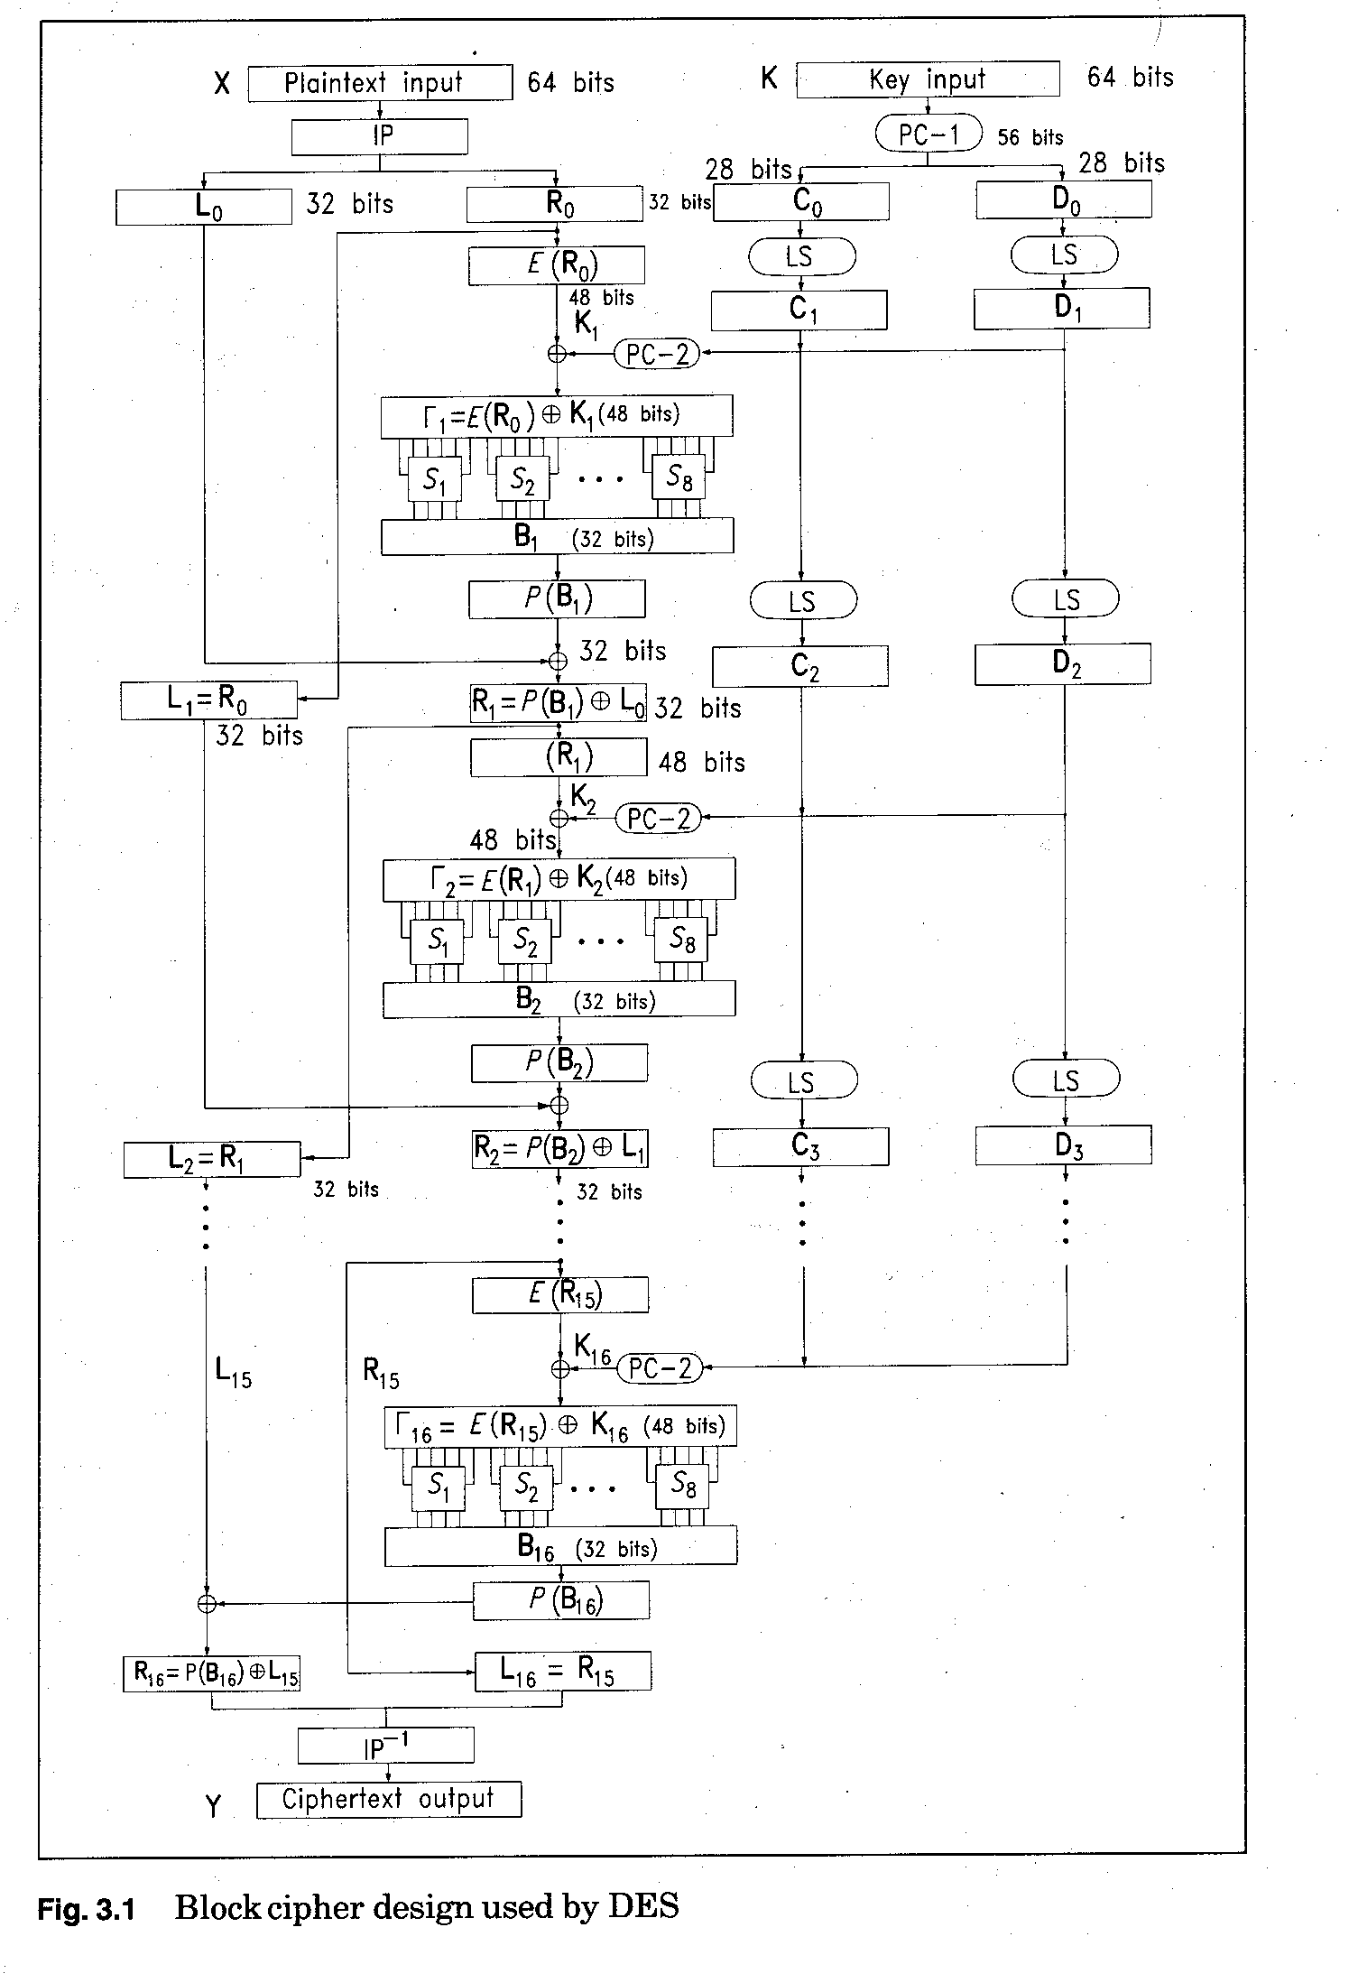

Slide 6
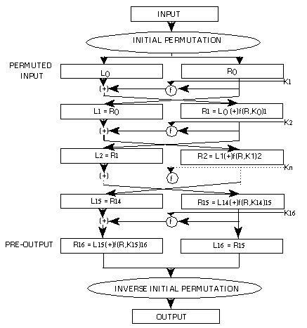
A more Simpler View of DES

Slide 7
DES
DES works on bits, or binary numbers
The 0s and 1s common to digital computers. Each group of four bits makes up a hexadecimal, or base 16, number and "1111" is equal to the hexadecimal number "F".
To do the encryption, DES uses "keys" where are also apparently 16 hexadecimal numbers long, or apparently 64 bits long. However, every 8th key bit is ignored in the DES algorithm, so that the effective key size is 56 bits
if we take the plaintext message "8787878787878787", and encrypt it with the DES key "0E329232EA6D0D73", we end up with the ciphertext "0000000000000000".
If the ciphertext is decrypted with the same secret DES key "0E329232EA6D0D73", the result is the original plaintext "8787878787878787".

Slide 8
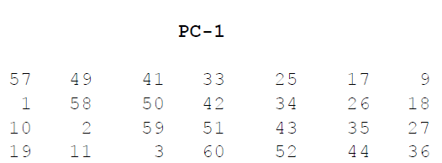
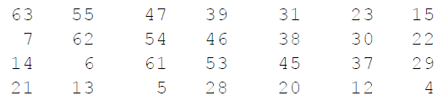
How DES works
Step 1: Create 16 subkeys, each of which is 48-bits long.
The 64-bit key is permuted according to the following table, PC-1.
Since the first entry in the table is "57", this means that the 57th bit of the original key K becomes the first bit of the permuted key K+. The 49th bit of the original key becomes the second bit of the permuted key.

Slide 9

How DES Works: Step1
Suppose
K = 00010011 00110100 01010111 01111001 10011011 10111100 11011111 11110001
we get the 56-bit permutation
K+ = 1111000 0110011 0010101 0101111 0101010 1011001 1001111 0001111
Next, split this key into left and right halves, C₀ and D₀, where each half has 28 bits.
Example: From the permuted key K+, we get
C₀ = 1111000 0110011 0010101 0101111 D₀ = 0101010 1011001 1001111 0001111

Slide 10
00010011
00110100
01010111
01111001
10011011
10111100
11011111
11110001

Slide 11
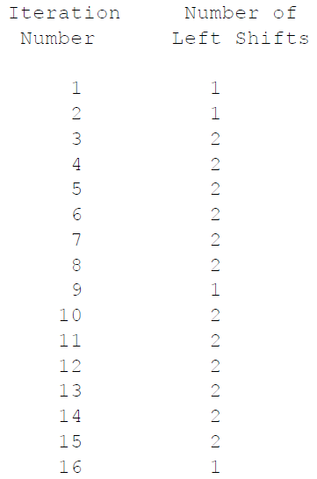
How DES Works: Step1
With C₀ and D₀ defined, we
now create sixteen blocks
C_{n} and D_{n}, 1<=n<=16.
Each pair of blocks C_{n} and D_{n}
is formed from the previous
pair C_{n-1} and D_{n-1}, respectively,
for n = 1, 2, ..., 16, using the
following schedule of "left shifts“
of the previous block.
To do a left shift, move each bit one place to the left, except for the first bit, which is cycled to the end of the block.

Slide 12
How DES Works: Step1
Example: From original pair C₀ and D₀ we obtain:
C₀ = 1111000011001100101010101111 C₉ = 0101010101111111100001100110 D₀ = 0101010101100110011110001111 D₉ = 0011110001111010101010110011
C₁ = 1110000110011001010101011111 C₁₀ = 0101010111111110000110011001 D₁ = 1010101011001100111100011110 D₁₀ = 1111000111101010101011001100
C₂ = 1100001100110010101010111111 C₁₁ = 0101011111111000011001100101 D₂ = 0101010110011001111000111101 D₁₁ = 1100011110101010101100110011
C₃ = 0000110011001010101011111111 C₁₂ = 0101111111100001100110010101 D₃ = 0101011001100111100011110101 D₁₂ = 0001111010101010110011001111
C₄ = 0011001100101010101111111100 C₁₃ = 0111111110000110011001010101 D₄ = 0101100110011110001111010101 D₁₃ = 0111101010101011001100111100
C₅ = 1100110010101010111111110000 C₁₄ = 1111111000011001100101010101 D₅ = 0110011001111000111101010101 D₁₄ = 1110101010101100110011110001
C₆ = 0011001010101011111111000011 C₁₅ = 1111100001100110010101010111 D₆ = 1001100111100011110101010101 D₁₅ = 1010101010110011001111000111
C₇ = 1100101010101111111100001100 C₁₆ = 1111000011001100101010101111 D₇ = 0110011110001111010101010110 D₁₆ = 0101010101100110011110001111
C₈ = 0010101010111111110000110011 D₈ = 1001111000111101010101011001

Slide 13
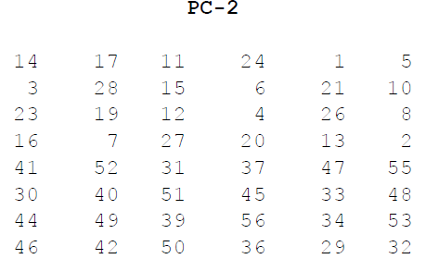
How DES Works: Step1
We now form the keys K_{n}, for 1<=n<=16, by applying the following permutation table to each of the concatenated pairs C_{n}D_{n}. Each pair has 56 bits, but PC-2 only uses 48 of these.
Therefore, the first bit of K_{n} is the 14th bit of C_{n}D_{n}, the second bit the 17th, and so on, ending with the 48th bit of K_{n} being the 32th bit of C_{n}D_{n}.

Slide 14
How DES Works: Step1
Example: For the first key we have C₁D₁ = 1110000 1100110 0101010 1011111 1010101 0110011 0011110 0011110
which, after we apply the permutation PC-2, becomes
K₁ = 000110 110000 001011 101111 111111 000111 000001 110010
For the other keys we have
K₂ = 011110 011010 111011 011001 110110 111100 100111 100101 K₃ = 010101 011111 110010 001010 010000 101100 111110 011001 K₄ = 011100 101010 110111 010110 110110 110011 010100 011101 K₅ = 011111 001110 110000 000111 111010 110101 001110 101000 K₆ = 011000 111010 010100 111110 010100 000111 101100 101111 K₇ = 111011 001000 010010 110111 111101 100001 100010 111100 K₈ = 111101 111000 101000 111010 110000 010011 101111 111011 K₉ = 111000 001101 101111 101011 111011 011110 011110 000001 K₁₀ = 101100 011111 001101 000111 101110 100100 011001 001111 K₁₁ = 001000 010101 111111 010011 110111 101101 001110 000110 K₁₂ = 011101 010111 000111 110101 100101 000110 011111 101001 K₁₃ = 100101 111100 010111 010001 111110 101011 101001 000001 K₁₄ = 010111 110100 001110 110111 111100 101110 011100 111010 K₁₅ = 101111 111001 000110 001101 001111 010011 111100 001010 K₁₆ = 110010 110011 110110 001011 000011 100001 011111 110101

Slide 15
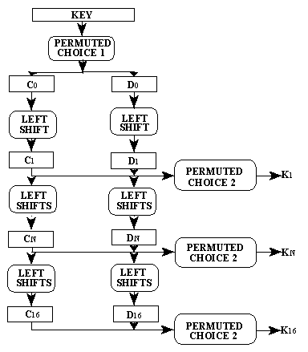





How DES works: Step 1

Slide 16
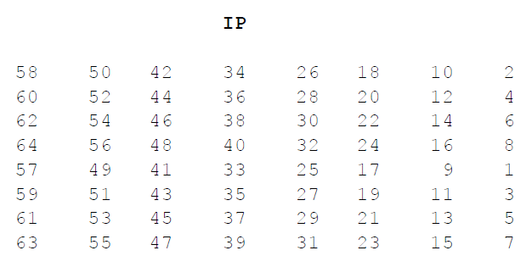
How DES Works: Step2
Step 2: Encode each 64-bit block of data.
There is an initial permutation IP of the 64 bits of the message data M.
This rearranges the bits according
to the following table, where
the entries in the table
show the new arrangement
of the bits from their initial
order.
The 58th bit of M
becomes the first bit of IP.
The 50th bit of M becomes
the second bit of IP.

Slide 17
How DES Works: Step2
Example: Applying the initial permutation to the block of text M, given previously, we get
M = 0000 0001 0010 0011 0100 0101 0110 0111 1000 1001 1010 1011 1100 1101 1110 1111 IP = 1100 1100 0000 0000 1100 1100 1111 1111 1111 0000 1010 1010 1111 0000 1010 1010
Here the 58th bit of M is "1", which becomes the first bit of IP. The 50th bit of M is "1", which becomes the second bit of IP. The 7th bit of M is "0", which becomes the last bit of IP.
Next divide the permuted block IP into a left half L₀ of 32 bits, and a right half R₀ of 32 bits.
Example: From IP, we get L₀ and R₀
L₀ = 1100 1100 0000 0000 1100 1100 1111 1111 R₀ = 1111 0000 1010 1010 1111 0000 1010 1010

Slide 18
How DES Works: Step2
We now proceed through 16 iterations, for 1<=n<=16, using a function f which operates on two blocks--a data block of 32 bits and a key K_{n} of 48 bits--to produce a block of 32 bits.
Let + denote XOR addition, (bit-by-bit addition modulo 2). Then for n going from 1 to 16 we calculate
L_{n} = R_{n-1} R_{n} = L_{n-1} + f(R_{n-1},K_{n})
This results in a final block, for n = 16, of L₁₆R₁₆.
That is, in each iteration, we take the right 32 bits of the previous result and make them the left 32 bits of the current step.
For the right 32 bits in the current step, we XOR the left 32 bits of the previous step with the calculation f .

Slide 19
How DES Works: Step2
Example: For n = 1, we have
K₁ = 000110 110000 001011 101111 111111 000111 000001 110010 L₁ = R₀ = 1111 0000 1010 1010 1111 0000 1010 1010 R₁ = L₀ + f(R₀,K₁)
It remains to explain how the function f works.
To calculate f, we first expand each block R_{n-1} from 32 bits to 48 bits. This is done by using a selection table that repeats some of the bits in R_{n-1} .
We'll call the use of this selection table the function E. Thus E(R_{n-1}) has a 32 bit input block, and a 48 bit output block.
Let E be such that the 48 bits of its output, written as 8 blocks of 6 bits each, are obtained by selecting the bits in its inputs in order according to the following table:

Slide 20
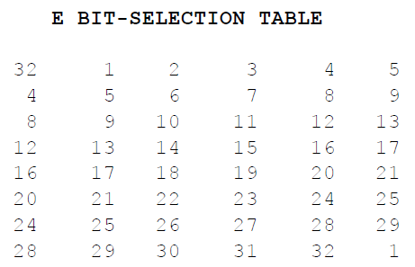
How DES Works: Step2
Thus the first three bits of E(R_{n-1}) are the bits in positions 32, 1 and 2 of R_{n-1} while the last 2 bits of E(R_{n-1}) are the bits in positions 32 and 1.
Example: We calculate E(R₀) from R₀ as follows:
R₀ = 1111 0000 1010 1010 1111 0000 1010 1010 E(R₀) = 011110 100001 010101 010101 011110 100001 010101 010101
(Note that each block of 4 original bits has been expanded to a block of 6 output bits.)

Slide 21
How DES Works: Step2
Next in the f calculation, we XOR the output E(R_{n-1}) with the key K_{n}: K_{n} + E(R_{n-1}).
Example: For K₁ , E(R₀), we have
K₁ = 000110 110000 001011 101111 111111 000111 000001 110010 E(R₀) = 011110 100001 010101 010101 011110 100001 010101 010101 K₁+E(R₀) = 011000 010001 011110 111010 100001 100110 010100 100111.
We have not yet finished calculating the function f .
To this point we have expanded R_{n-1} from 32 bits to 48 bits, using the selection table, and XORed the result with the key K_{n} .
We now have 48 bits, or eight groups of six bits.
We now do something strange with each group of six bits: we use them as addresses in tables called "S boxes".

Slide 22
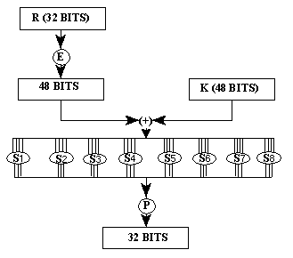
How DES works: Step 2

Slide 23
How DES Works: Step2
Each group of six bits will give us an address in a different S box. Located at that address will be a 4 bit number.
This 4 bit number will replace the original 6 bits.
The net result is that the eight groups of 6 bits are transformed into eight groups of 4 bits (the 4-bit outputs from the S boxes) for 32 bits total.
Write the previous result, which is 48 bits, in the form:
K_{n} + E(R_{n-1}) =B₁B₂B₃B₄B₅B₆B₇B₈, where each B_{i} is a group of six bits.
We now calculate
S₁(B₁)S₂(B₂)S₃(B₃)S₄(B₄)S₅(B₅)S₆(B₆)S₇(B₇)S₈(B₈)
where S_{i}(B_{i}) refers to the output of the i-th S box.
To repeat, each of the functions S1, S2,..., S8, takes a 6-bit block as input and yields a 4-bit block as output.

Slide 24
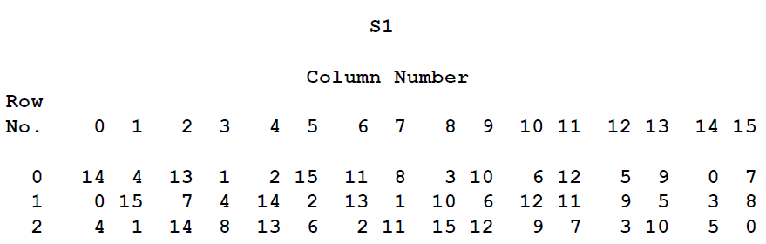
How DES Works: Step2
The table to determine S₁ is shown and explained below:

Slide 25
How DES Works: Step2
If S₁ is the function defined in this table and B is a block of 6 bits, then S₁(B) is determined as follows:
The first and last bits of B represent in base 2 a number in the decimal range 0 to 3 (or binary 00 to 11). Let that number be i.
The middle 4 bits of B represent in base 2 a number in the decimal range 0 to 15 (binary 0000 to 1111). Let that number be j.
Look up in the table the number in the i-th row and j-th column.
It is a number in the range 0 to 15 and is uniquely represented by a 4 bit block.
That block is the output S₁(B) of S₁ for the input B.
For example, for input block B = 011011 the first bit is "0" and the last bit "1" giving 01 as the row. This is row 1. The middle four bits are "1101". This is the binary equivalent of decimal 13, so the column is column number 13.
In row 1, column 13 appears 5. This determines the output; 5 is binary 0101, so that the output is 0101.
Hence S₁(011011) = 0101.

Slide 26
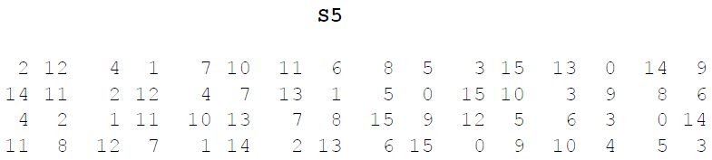
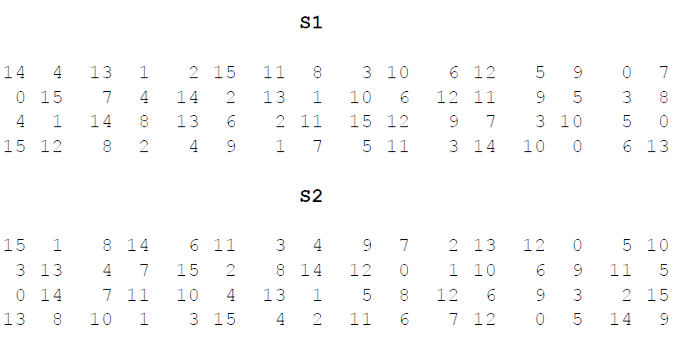
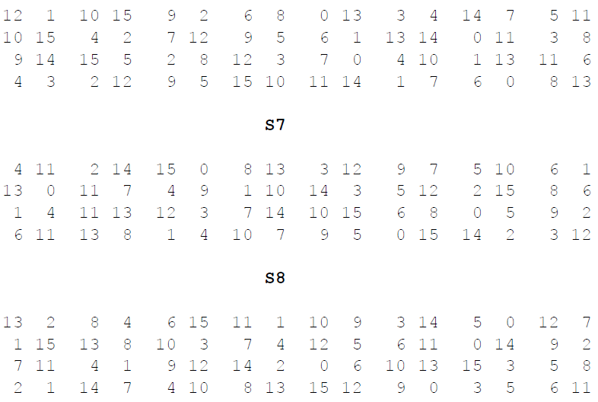
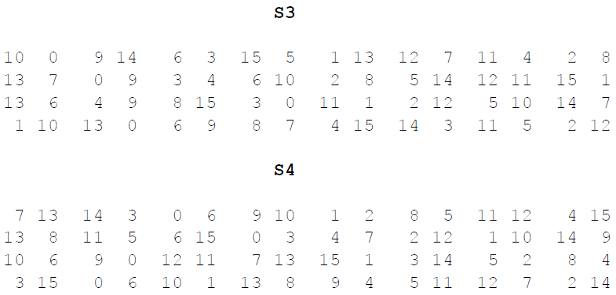
How DES Works: Step2
The tables defining the functions S₁,...,S₈ are the following:

Slide 27
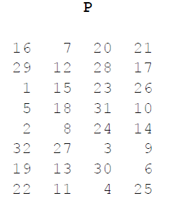
How DES Works: Step2
Example: For the first round, we obtain as the output of the eight S boxes:
K₁ + E(R₀) = 011000 010001 011110 111010 100001 100110 010100 100111.
S₁(B₁)S₂(B₂)S₃(B₃)S₄(B₄)S₅(B₅)S₆(B₆)S₇(B₇)S₈(B₈) =
0101 1100 1000 0010 1011 0101 1001 0111
The final stage in the calculation of f is to do a permutation P of the S-box output to obtain the final value of f:
f = P(S₁(B₁)S₂(B₂)...S₈(B₈)) The
permutation P is defined in the following
table.
P yields a 32-bit output from a 32-bit input
by permuting the bits of the input block.

Slide 28
How DES Works: Step2
Example: From the output of the eight S boxes:
S₁(B₁)S₂(B₂)S₃(B₃)S₄(B₄)S₅(B₅)S₆(B₆)S₇(B₇)S₈(B₈) =
0101 1100 1000 0010 1011 0101 1001 0111 we get
f = 0010 0011 0100 1010 1010 1001 1011 1011
R₁ = L₀ + f(R₀ , K₁ ) = 1100 1100 0000 0000 1100 1100 1111 1111 + 0010 0011 0100 1010 1010 1001 1011 1011 = 1110 1111 0100 1010 0110 0101 0100 0100
In the next round, we will have L₂ = R₁, which is the block we just calculated, and then we must calculate R₂ =L₁ + f(R₁, K₂), and so on for 16 rounds.
At the end of the sixteenth round we have the blocks L₁₆ and R₁₆. We then reverse the order of the two blocks into the 64-bit block
R₁₆L₁₆

Slide 29
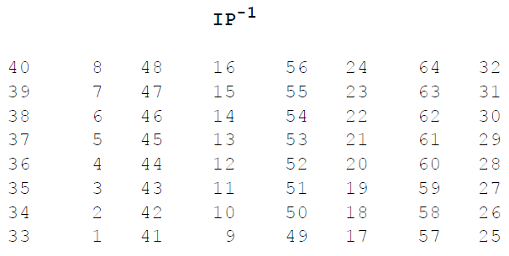
How DES Works: Step2
And apply a final permutation IP⁻¹ as defined by the following table:
That is, the output of the algorithm has bit 40 of the preoutput block as its first bit, bit 8 as its second bit, and so on, until bit 25 of the preoutput block is the last bit of the output.

Slide 30
How DES Works: Step2
Example: If we process all 16 blocks using the method defined previously, we get, on the 16th round,
L₁₆ = 0100 0011 0100 0010 0011 0010 0011 0100 R₁₆ = 0000 1010 0100 1100 1101 1001 1001 0101
We reverse the order of these two blocks and apply the final permutation to
R₁₆L₁₆ = 00001010 01001100 11011001 10010101 01000011 01000010 00110010 00110100
IP⁻¹ = 10000101 11101000 00010011 01010100 00001111 00001010 10110100 00000101
which in hexadecimal format is 85E813540F0AB405.
This is the encrypted form of M = 0123456789ABCDEF:
namely, C = 85E813540F0AB405.
Decryption is simply performing operations in reverse mode using same key

Slide 32
DES Decryption
decrypt must unwind steps of data computation with Feistel design, do encryption steps again using subkeys in reverse order (SK16 … SK1)
note that IP undoes final FP step of encryption 1st round with SK16 undoes 16th encrypt round….
16th round with SK1 undoes 1st encrypt round then final FP undoes initial encryption IP thus recovering original data value

Slide 33
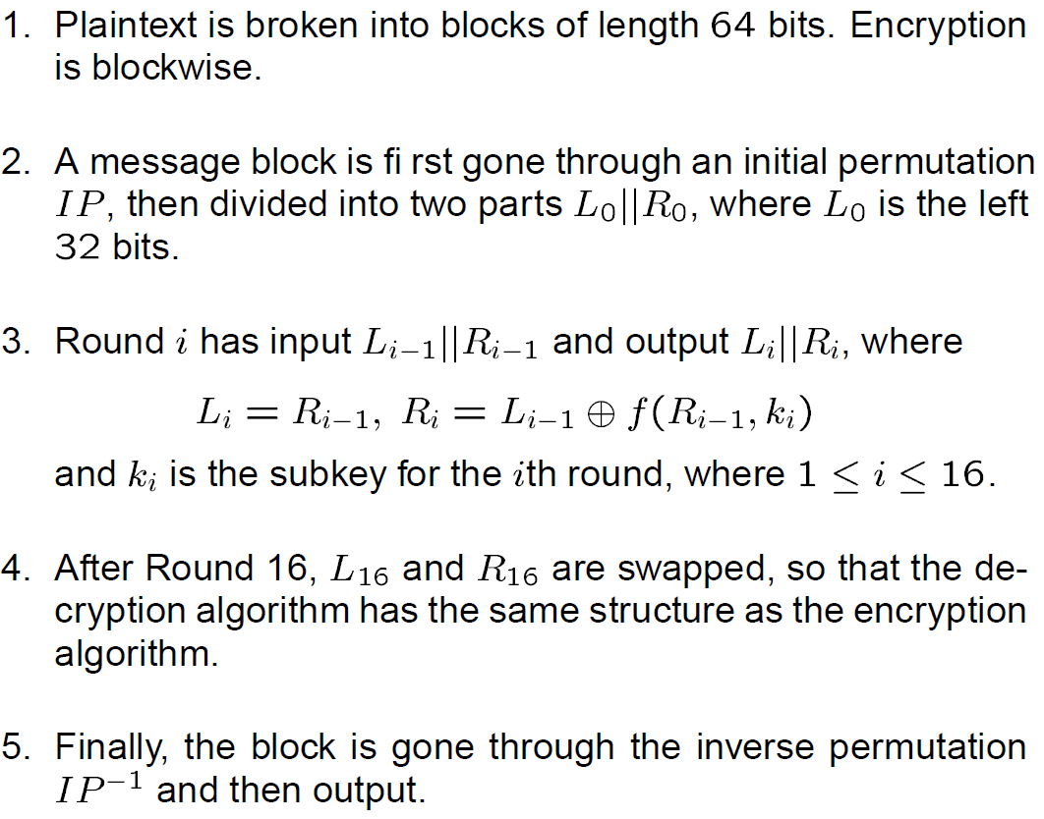
DES Algorithm

Slide 34
DES modes
The DES can be implemented into four different modes of operation
two block cipher modes whereas the plaintext data bits are enciphered as 64-bit data blocks,
as well as two stream cipher modes where the plaintext data bits are encrypted individually.
Block cipher modes:
Electronic Codebook Mode (ECB)
Cipher Block Chaining Mode (CBC)
Stream cipher modes:
Output Feedback Mode (OFB)
Cipher Feedback Mode (CFB)

Slide 35


DES modes :ECB
In this mode, each block of plaintext is independently encrypted into a respective block of ciphertext.
Repeated blocks of identical plaintext result in repeated blocks of ciphertext, which can aid cryptanalysis of the ciphertext.
This effect is best illustrated.
The first image is the SANS logo (bitmap format);
the second image is the SANS logo bitmap encrypted via DES ECB mode.
Although the bitmap data is encrypted, the original pattern is clearly visible.
In this mode, errors
do not propagate, as each
block is encrypted
independently

Slide 36

DES modes: CBC
Cipher Block Chaining Mode is a block cipher which XORs (exclusive OR) each new block of plaintext with the previous block of ciphertext (they are “chained” together).
This means repeated blocks of plaintext do not result in repeated blocks of ciphertext.
Here is the same SANS logo bitmap data, encrypted with DES CBC mode
No pattern is visible in the same picture.
This is true for all DES modes other than ECB.
In this mode, errors propagate

Slide 38
DES modes: CFB
Cipher Feedback mode is a stream cipher that encrypts plaintext by breaking it into units of X (from 1 to 64) bits. This allows bit or byte-level encryption.
CFB mode uses a random initialization vector, and previous units of ciphertext are XORed with subsequent units of plaintext (the cipher is “fed back” to the plaintext)
As with CBC, errors propagate.

Slide 39
DES modes: OFB
Like CFB mode, Output Feedback mode uses a random initialization vector and encrypts plaintext by breaking it down into a stream by encrypting units of X (from 1 to 64) bits of plaintext.
OFB mode differs from CFB mode by creating a pseudo-random stream of bits (called “output”), which is XORed with the plaintext during each step (the “output” is “fed back” to the plaintext).
Because the output (and not ciphertext) is XORed to the plaintext, errors do not propagate.

Slide 40
Triple DES
In 1998 the Electronic Frontier Foundation, using a specially developed computer called the DES Cracker, managed to break DES in less than 3 days. And this was done for under $250,000.
The encryption chip that powered the DES Cracker was capable of processing 88 billion keys per second. In addition, it has been shown that for a cost of one million dollars a dedicated hardware device can be built that can search all possible DES keys in about 3.5 hours.
Small key size of DES was a major problem for DES
DES algorithm applied three times
It is three times slower than regular DES (efficiency problem) but can be billions of times more secure if used properly.
Triple DES enjoys much wider use even today.

Slide 41
Triple DES
Triple DES was the answer to many of the shortcomings of DES.
Since it is based on the DES algorithm, it was very easy to modify existing software to use Triple DES.
It also has the advantage of proven reliability
However, even this more powerful version of DES may not be strong enough to protect data for very much longer.
Triple DES is simply another mode of DES operation.
It takes three 64-bit keys, for an overall key length of 192 bits.
In Private Encryptor, you simply type in the entire 192-bit (24 character) key rather than entering each of the three keys individually.

Slide 42
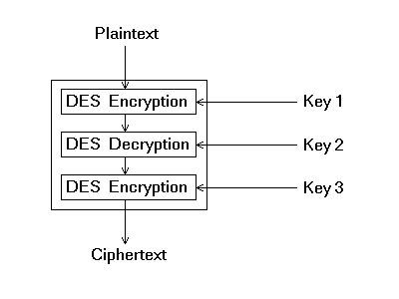
Triple DES
The Triple DES then breaks the user provided key into three subkeys,
The procedure for encryption is exactly the same as regular DES, but it is repeated three times. Hence the name Triple DES.
The data is encrypted with the first key, decrypted with the second key, and finally encrypted again with the third key.

Slide 43
IDEA
Developed in Switzerland 1991
128 bit key, 64 bit blocksize, 8 rounds
uses 52 subkeys, each 16 bits long
It has eight rounds.
algorithm is quite different than DES,
doesn’t use S-boxes
uses binary addition rather than exclusive-or
The plaintext block in IDEA is divided into four quarters, each 16 bits long.
Three operations are used in IDEA to combine two 16 bit values to produce a 16 bit result, addition(modulo 2¹⁶), XOR, and multiplication(modulo 2¹⁶+1).
Notes:
International Data Encryption Algorithm originally called Improved Proposed Encryption Standard (IPES)

Slide 44

IDEA
Let the four quarters of the plaintext be called A, B, C, and D, and the 52 subkeys called K(1) through K(52).
Before round 1, or as the first part of it, the following is done:
Multiply A by K(1). Add K(2) to B. Add K(3) to C. Multiply D by K(4).
Round 1 proper consists of the following:
Calculate A xor C (call it E) and B xor D (call it F).
Multiply E by K(5).
Add the new value of E to F.
Multiply the new value of F by K(6).
Add the result, which is also the new value of F, to E.
Change both A and C by XORing the current value of F with each of them;
change both B and D by XORing the current value of E with each of them.
Swap B and C.

Slide 45
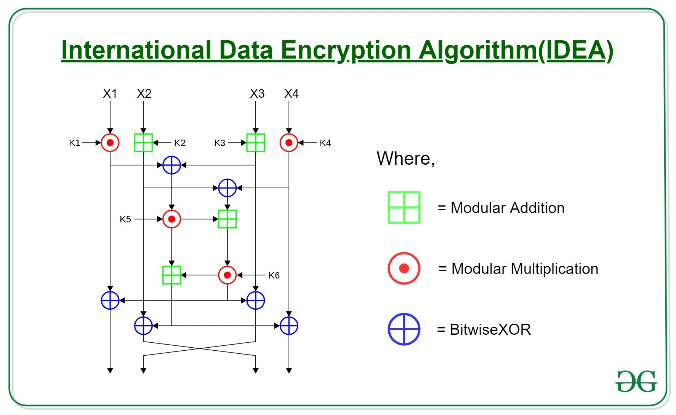

Slide 46
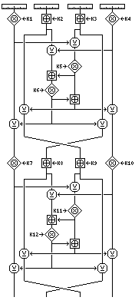
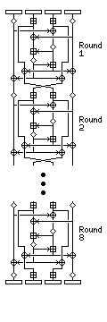
IDEA
Repeat all of this eight times, or seven more times, using K(7) through K(12) the second time, up to K(43) through K(48) the eighth time.
Note that the swap of B and C is
not performed after round 8.
Then multiply A by K(49).
Add K(50) to B.
Add K(51) to C.
Multiply D by K(52).

Slide 47

IDEA
Subkey generation
The 128-bit key of IDEA is taken as the first eight subkeys, K(1) through K(8).
The next eight subkeys are obtained the same way, after a 25-bit circular left shift, and this is repeated until all encryption subkeys are derived.
This method of subkey generation is regular, and this may be a weakness.
However, IDEA is considered to be highly secure, having stood up to all forms of attack so far tried by the academic community.

Slide 48
